Slide 1
MOTION APPROACH FOR TURRET SYSTEM PHYSICAL SIMULATION
Victor Paul, Andrew Hoelscher: US Army DEVCOM GVSC
Ahmed Tiguert, Harry Zywiol: DCS Corporation
DISTRIBUTION STATEMENT A.
Approved for public release; distribution is unlimited. OPSEC #10939

Slide 2
Agenda
Introduction
Safety
Payload Analysis
Collision Analysis
Motion Drive Creation
  Target File Creation
  Iteration Process
  Accuracy
  Repeatability
  Conclusion

Slide 3
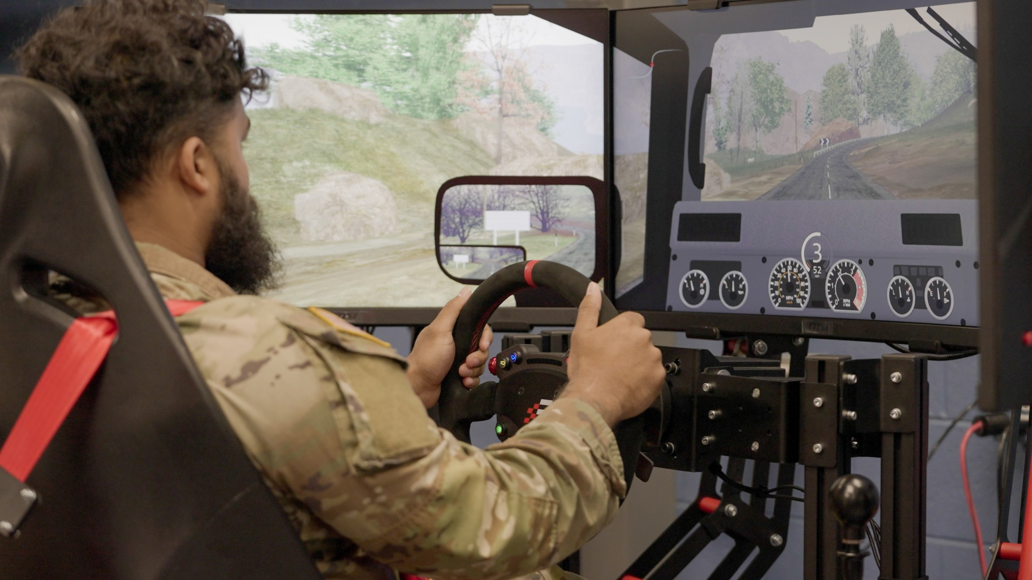
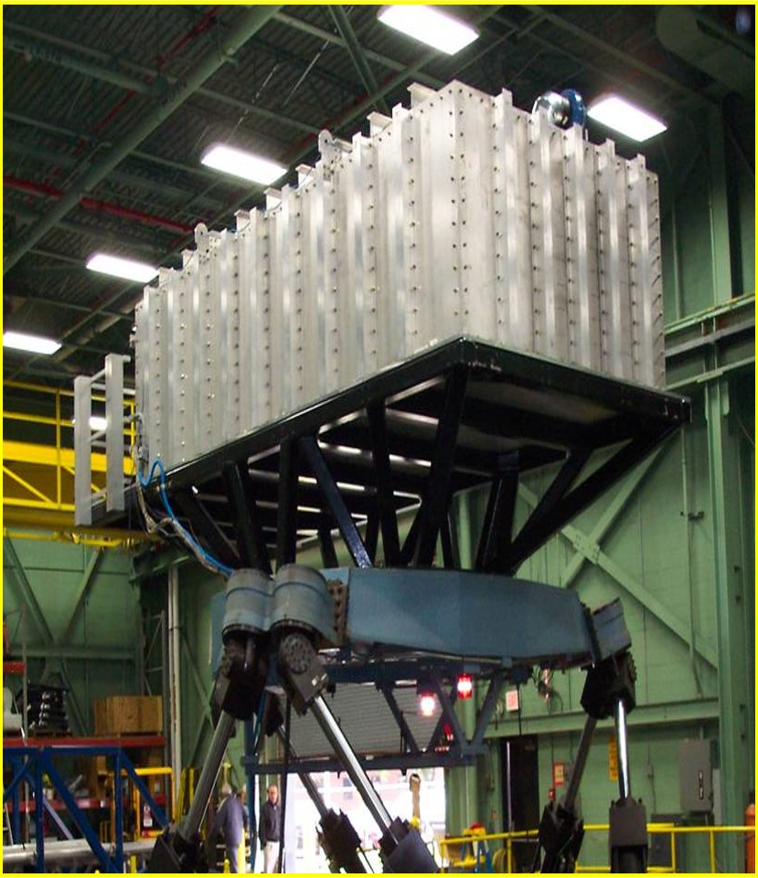
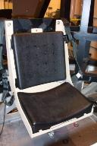
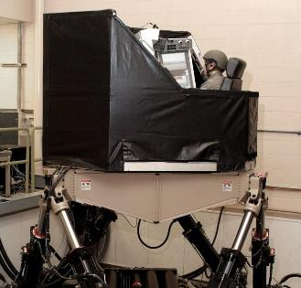
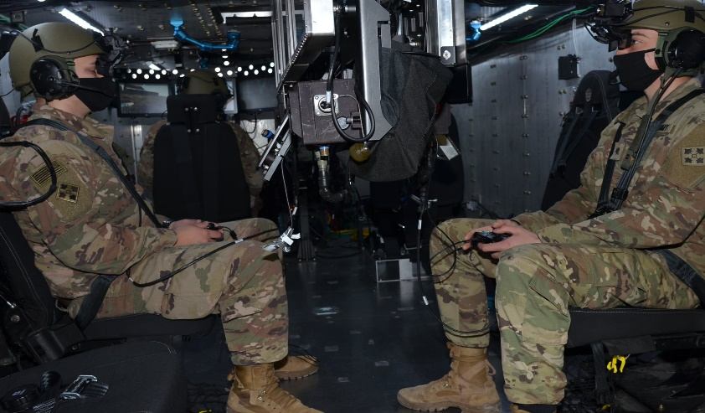
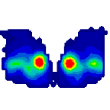
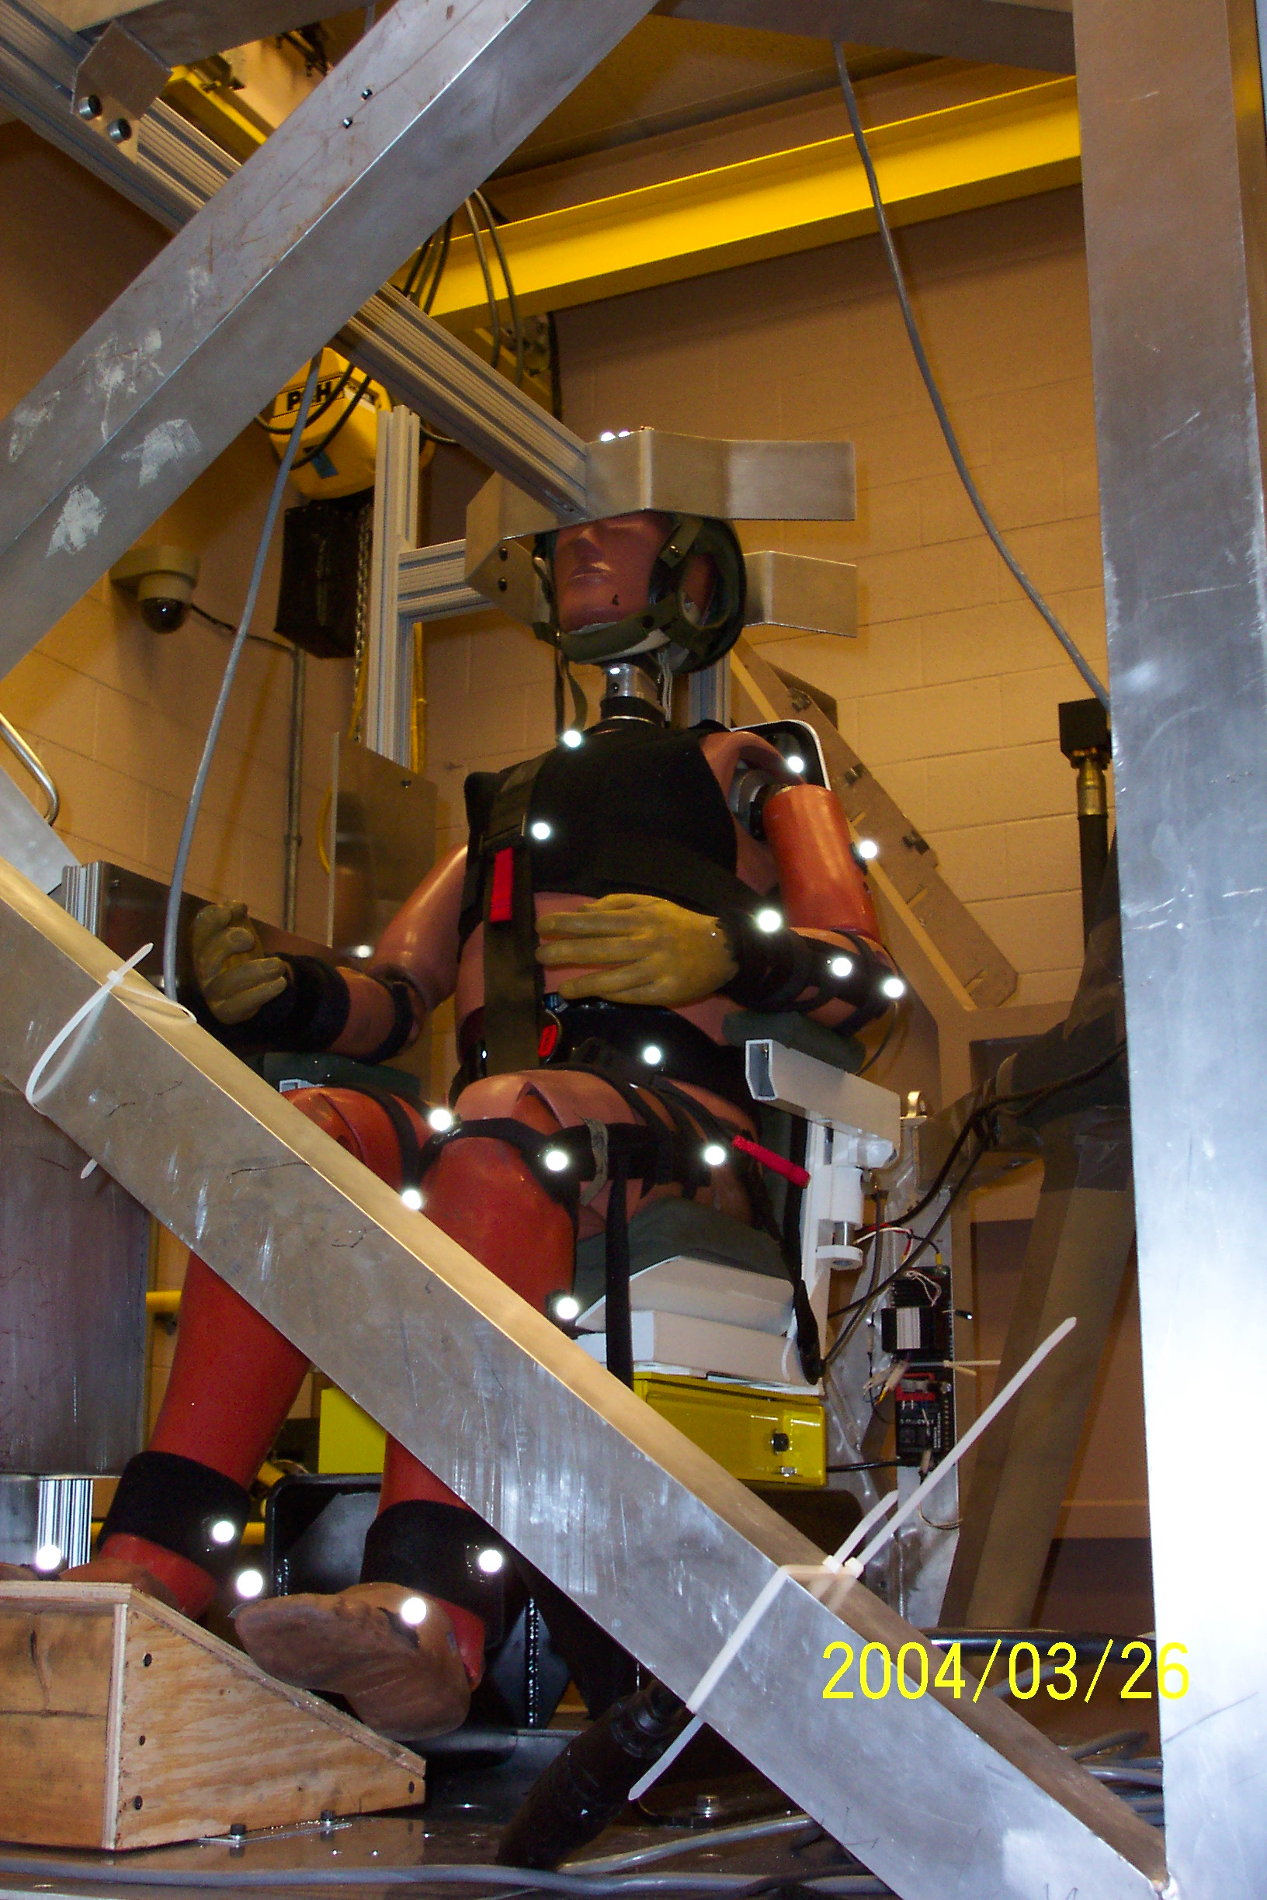
Motion Base Simulation Capabilities
Crew Familiarization/ Training
Simulation
Impulse Response
Closed Hatch
Crew Simulation
Seat Comfort
Multiple Crew Station Simulation
Turret Systems Simulation
Single Crew Station Simulation
Notes:
Immersive Simulations has two (2) six degree-of-freedom (6-DOF, longitudinal, lateral, heave, roll, pitch, yaw) motion base simulators located in the Ground Vehicle Simulation Laboratory in Bldg. 215.
1.) The Crew Station/Turret Motion Base Simulator (CS/TMBS) is a unique asset that can be used to stimulate Combat Vehicle Turret systems and to conduct full vehicle crew simulation. The simulator is capable of accommodating active, M1 class turrets to conduct gun/turret drive, weapon stab and ammo handling system development work in a dynamic environment.
In addition, the CS/TMBS is safety rated for soldier in the loop use to do full vehicle crew station simulation. The Mission Module cab is a reconfigurable space that can accommodate up to 9 crew members and is used to simulate the crew stations of closed hatch, indirect vision vehicle systems such as a Manned Control Vehicle and two Remote Combat Vehicles in a synthetic operational environment. This environment allows for development/evaluation of vehicle displays and controls, Warfighter Machine Interfaces, Helmet Mounted displays as well as crew aides and performance.
2.) The Ride Motion Simulator (RMS) is a single person simulator that is capable of recreating the motion of military vehicle traversing cross-country terrain. It too is safety rated for soldier-in-the-loop use and can be used to develop/evaluate many of the same things as the CS/TMBS but when only one (1) crew member is needed. In addition, the RMS can be used to evaluate seat comfort or physical interaction between crew members and their vehicle during high acceleration events.
3.) The Simulation Platform for Immersive Kinetic Engagement (SPIKE) two COTS Entertai1
1
nment simulators. The simulators were acquired to look at low-cost alternatives for motion simulation were the high-fidelity, high-acceleration dynamic environments were not needed such as for Crew Familiarization, Training Simulator prototyping or deployment of motion simulation at remote locations.

Slide 4
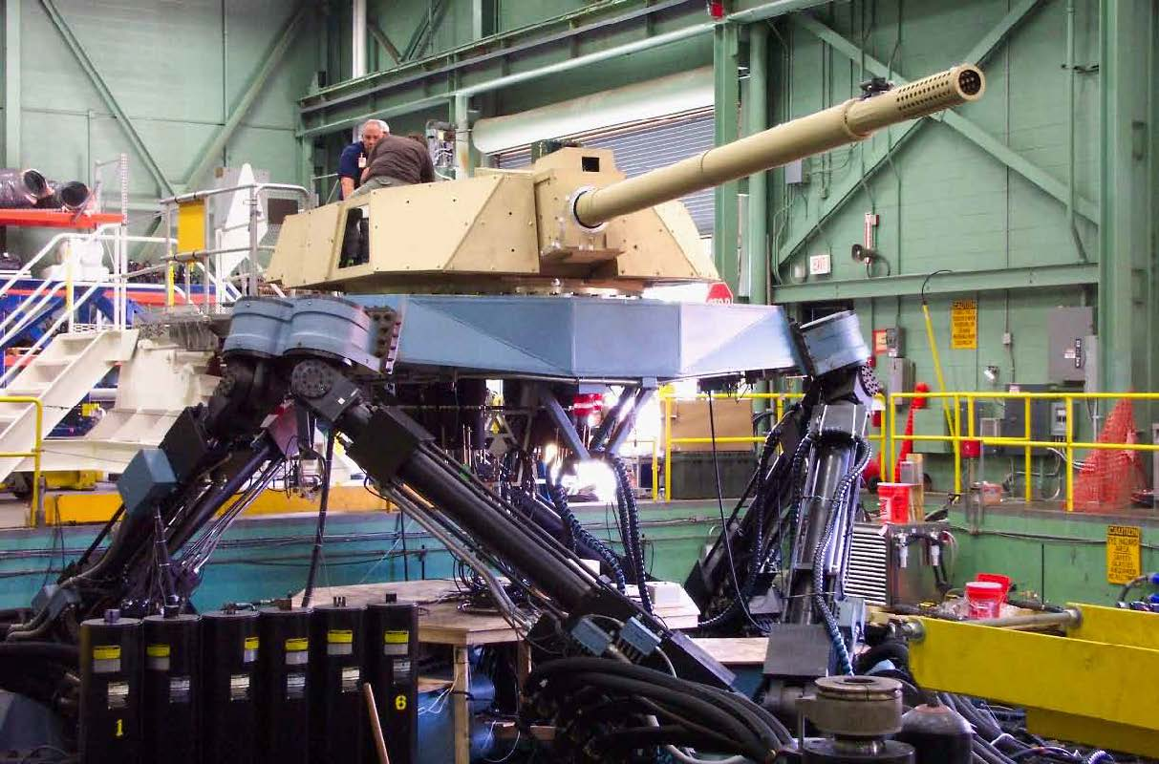
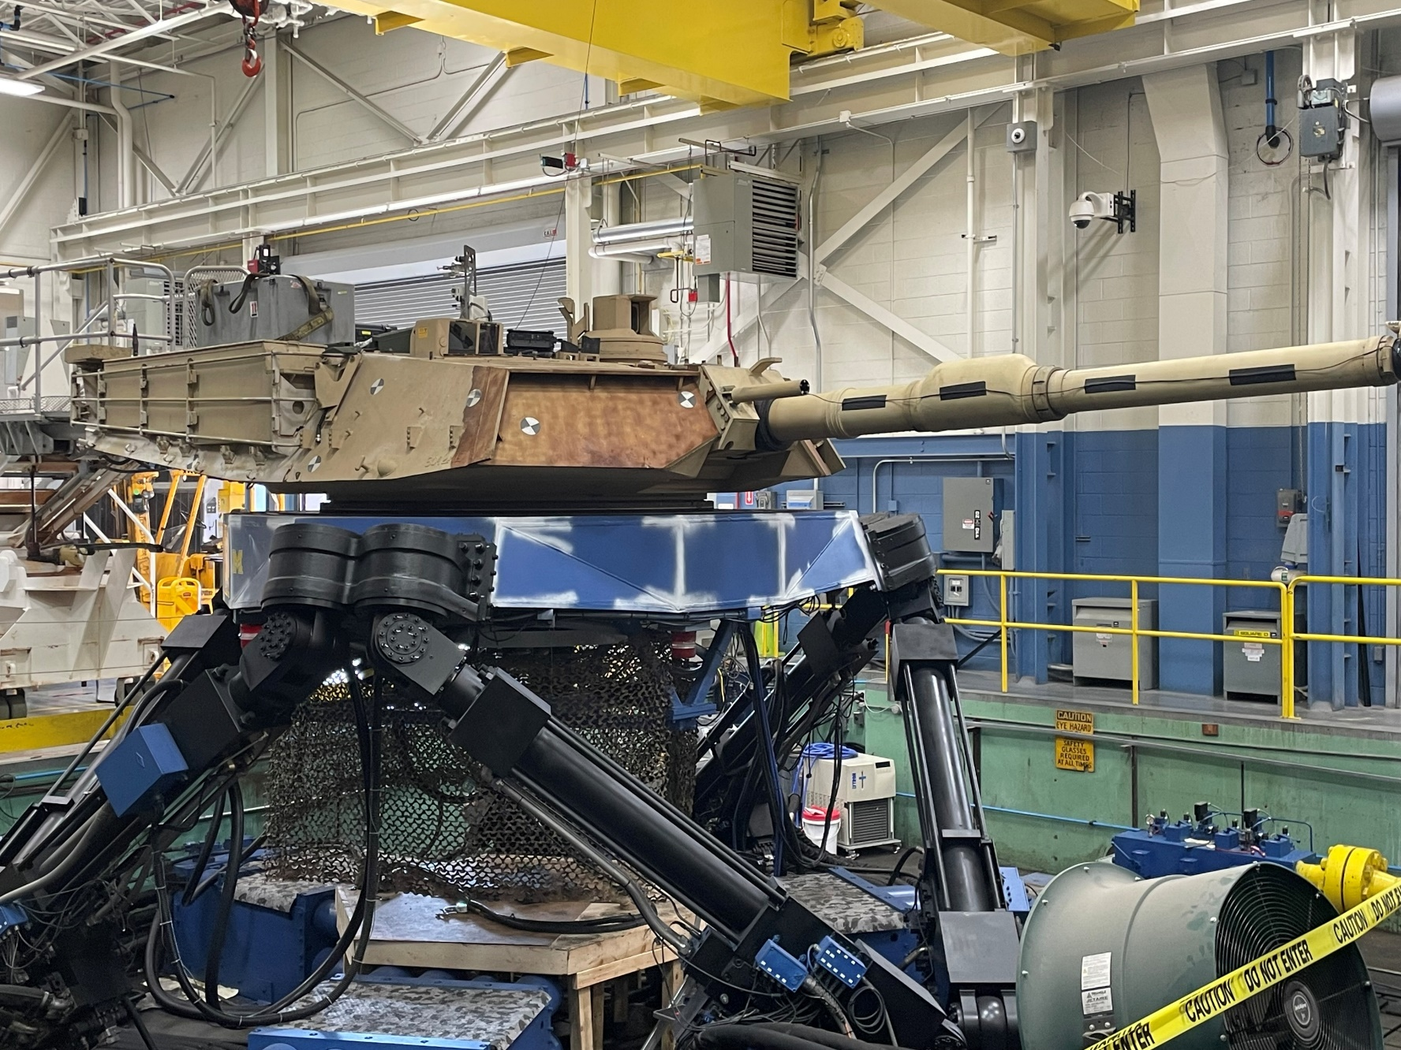

Slide 5
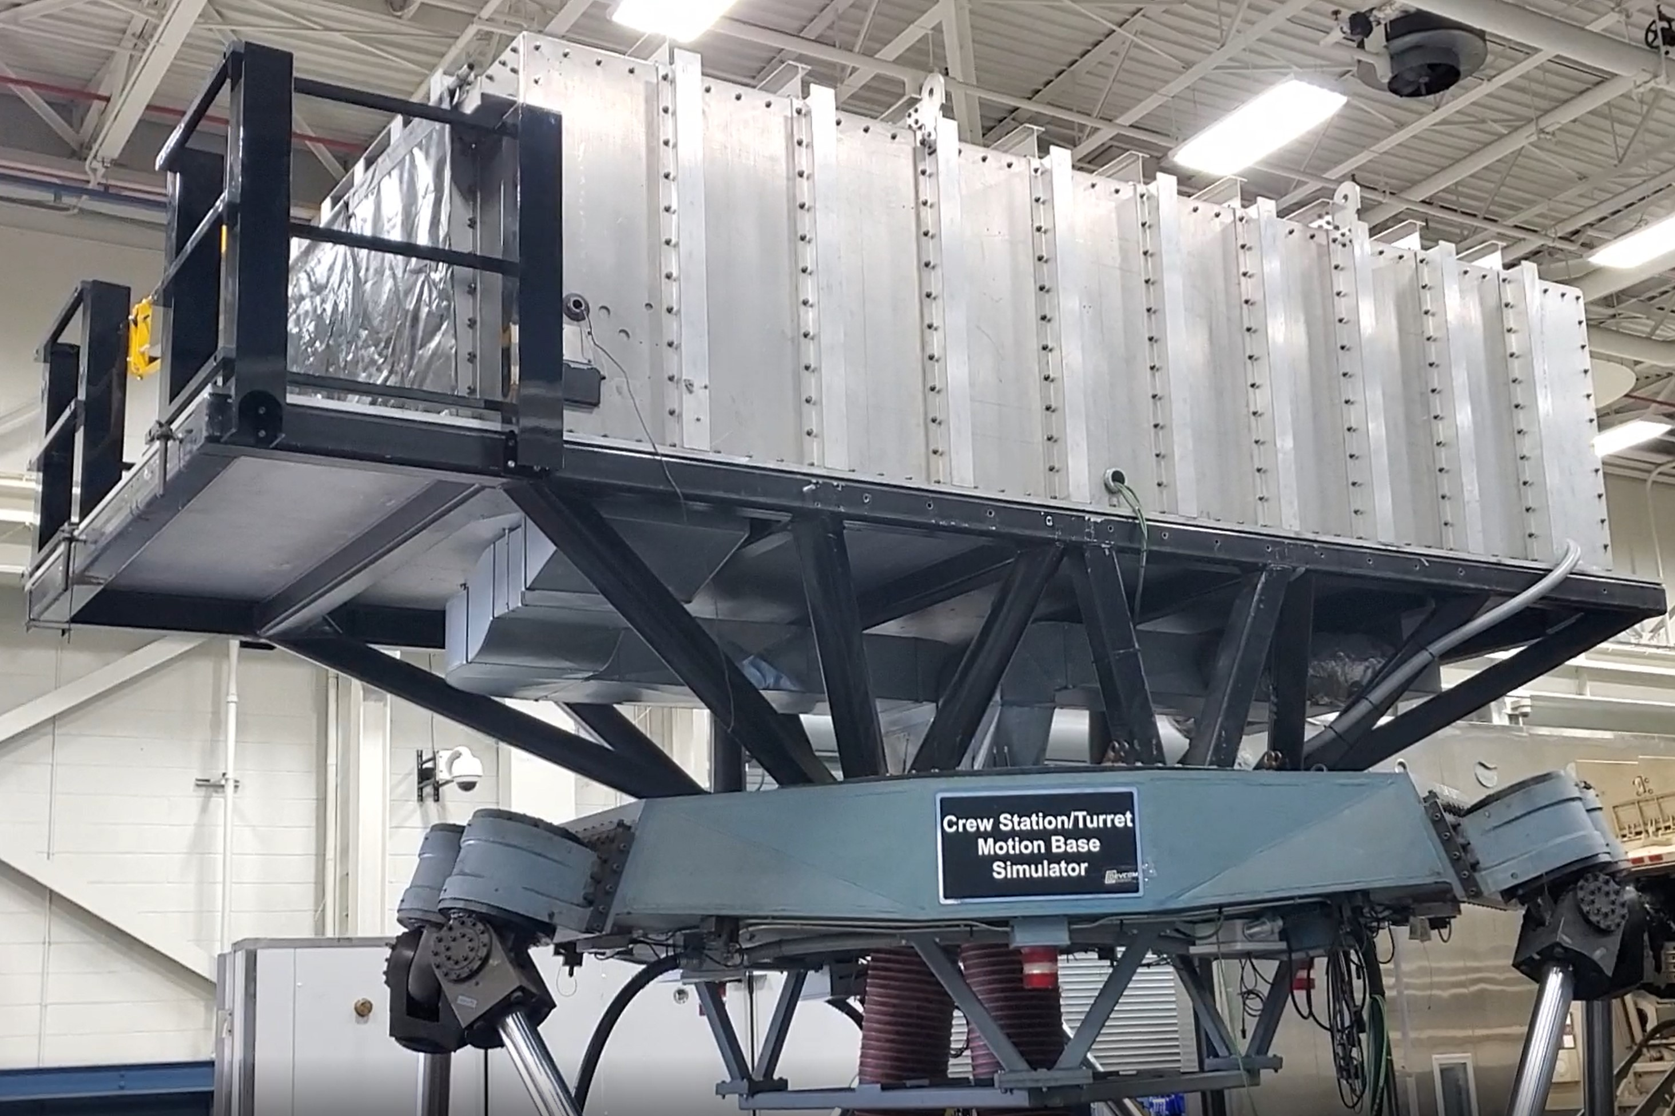
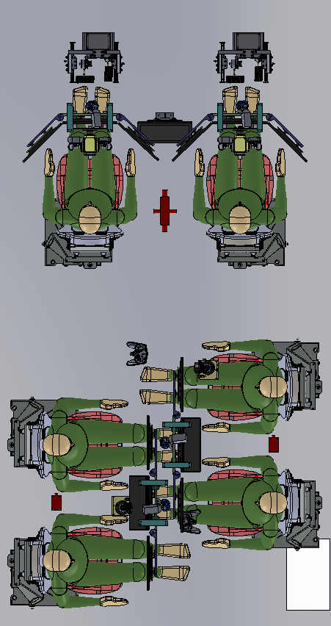
Crew Station/Turret Motion Base Simulator (CS/TMBS)
-Reconfigurable cab to replicate tracked or wheeled vehicle for entire crew.
-Can replicate current vehicle layout or concept vehicle crew configuration.
-Accommodates “Active” Combat Vehicle Turret Systems to test gun/turret drive and weapon stabilization
-Hexapod configuration (Stewart Platform)
-6 Degrees of Freedom (6-DOF: Lat, Long, Vertical (Heave), Roll, Pitch and Yaw
-Hydraulically Actuated
-Replicates the “ride” of military ground systems over several terrain types, including field collected data or analytical models
-Human in the loop real-time vehicle dynamics
-Human Safety Rated, commissioned in 1989
CS/TMBS Performance Specs
Payload | 25 tons
Acceleration Bandwidth | 10 Hz
Displacement
Linear (vert., lat., long.) | ± 1m
Angular (roll, pitch, yaw) | ± 20 deg
Acceleration
Linear (vert., lat., long.) | 4g, 2g, 2g
Angular (roll, pitch, yaw) | 2900,1760, 1940 deg/sec²

Slide 6
Safety

Slide 7
SAFETY – Payload Analysis
Initial Concern: CS/TMBS is safety rated at 50,000 lbs payload at 5 g’s. Can we safely operate at payloads up to 55,000 lbs?
CS/TMBS Design Criteria is 50,000 lbs payload with max acceleration of 5 g’s with safety factor of 2.0. Other design criteria include a safety factor of 4.0 with the worst-case loads of 4 g vertical and 3g arbitrarily directed with simultaneous 10 rad/sec² accelerations.
Analysis:
                Analysis performed for a 55,000 lb. turret.
              The Analysis “derates” maximum performance of CS/TMBS to maintain the 2.0 safety factor.
              Intended motion profiles were analyzed to compute worse case transient accelerations in all 6 degrees of freedom. All profiles produce relatively low accelerations of < 1g. Worse case profile produces about 25% of maximum>>Safety factor is preserved.
Simulator Max Capability
Axis | ± Acceleration at 50000 lbs | ± Acceleration at 55000 lbs
Long (Tx) | 17.6 m/s² | 15.9 m/s²
Lat (Ty) | 17.6 m/s² | 15.9 m/s²
Vert (Tz) | 58.8 m/s² | 44.6 m/s²
Roll (Rx) | 51 rad/s² | 46.3 rad/s²
Pitch (Ry) | 31 rad/s² | 28.1 rad/s²
Yaw (Rz) | 34 rad/s² | 30.9 rad/s²
Motion profiles maximums well below these new parameters

Slide 8
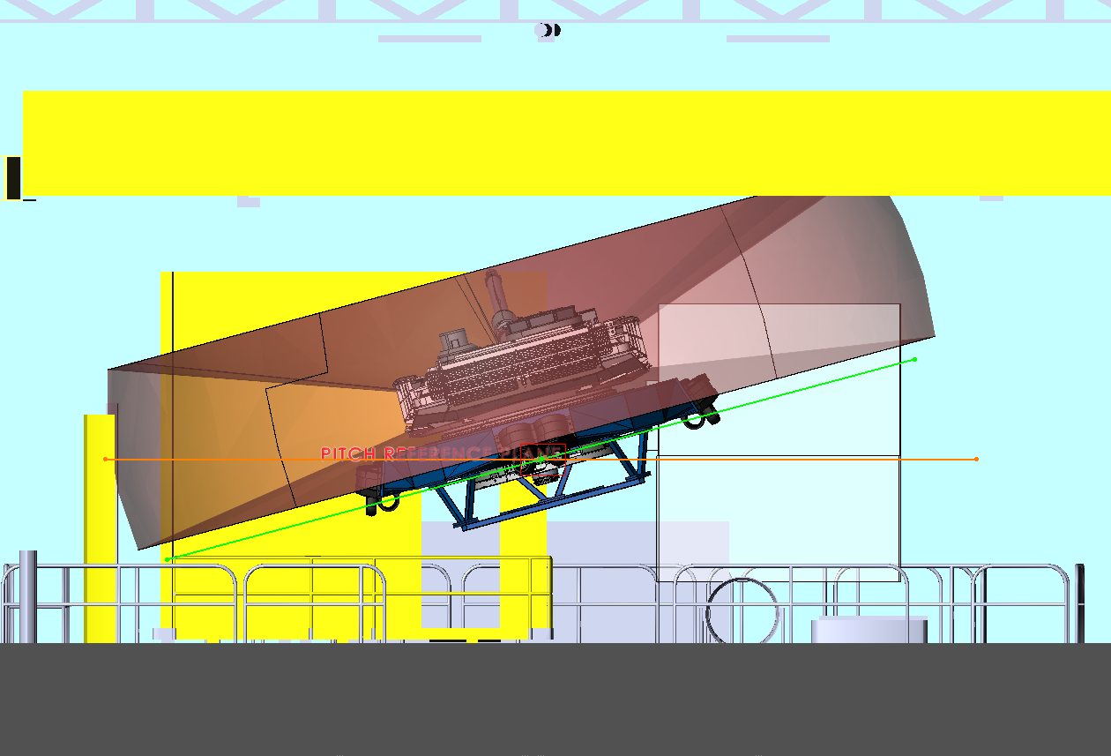
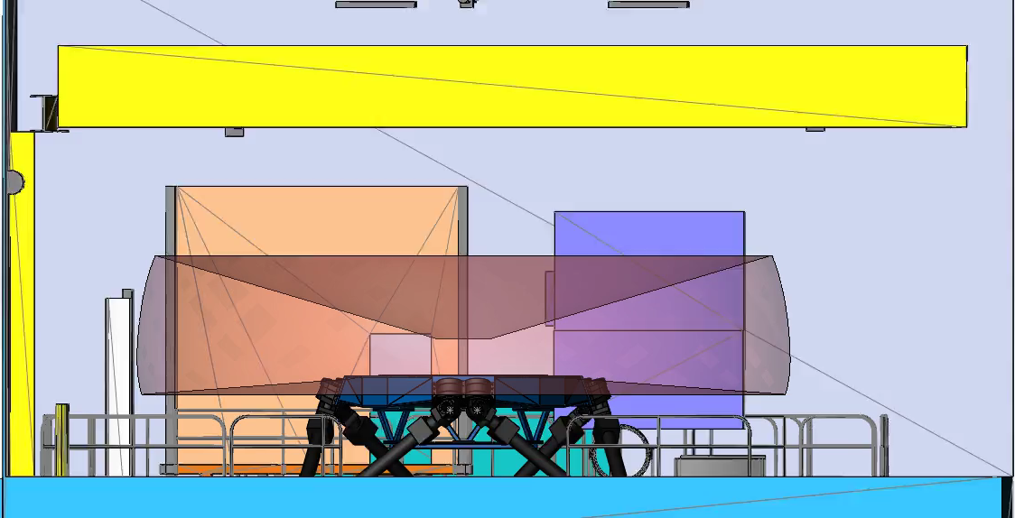
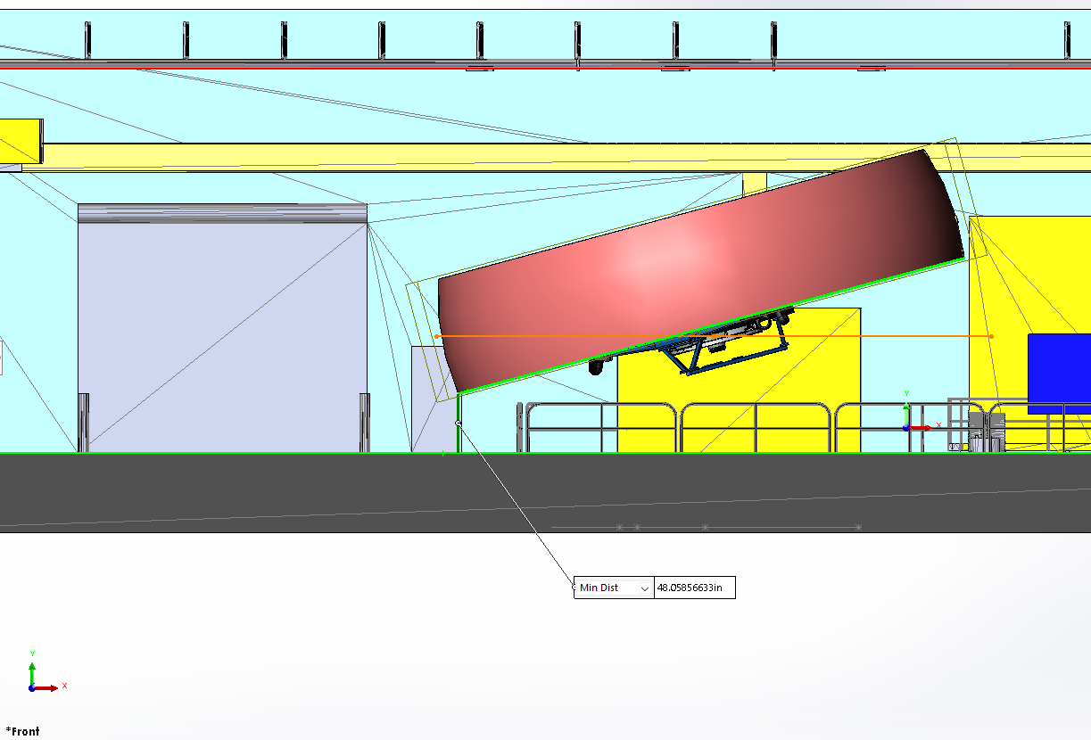
SAFETY – Collision Analysis

Slide 9
Motion Drive Creation

Slide 10
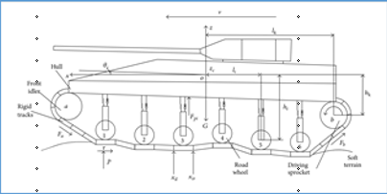
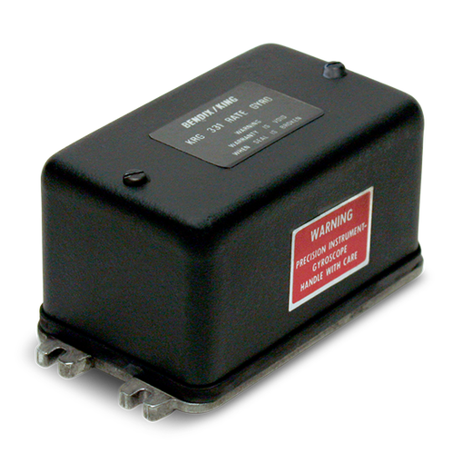
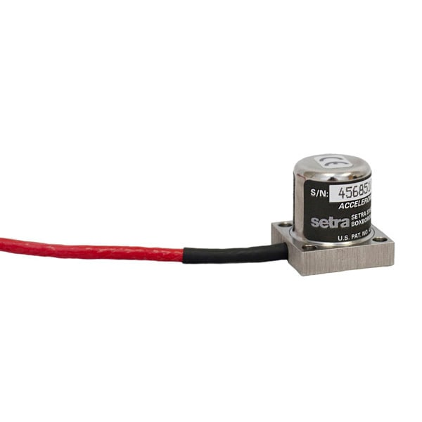
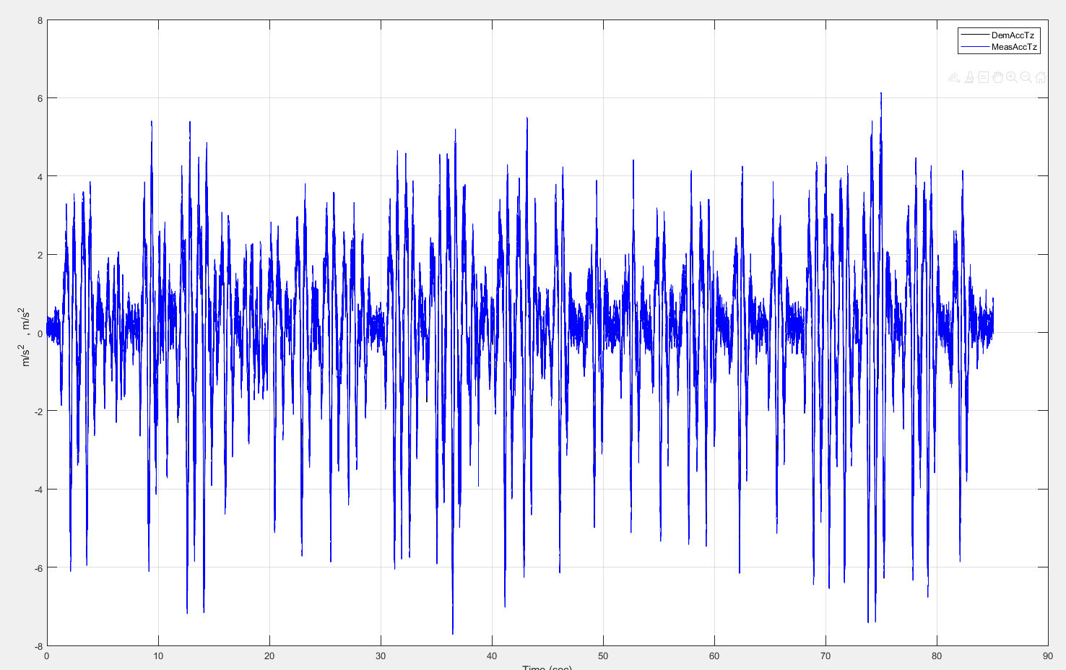
Target File Development
What is a Target File?
Target File = Desired platform response
Where do we start?
Analytical Model
Field Data
What do we need?
Acceleration, Rate or Position time histories of the turret
or

Slide 11
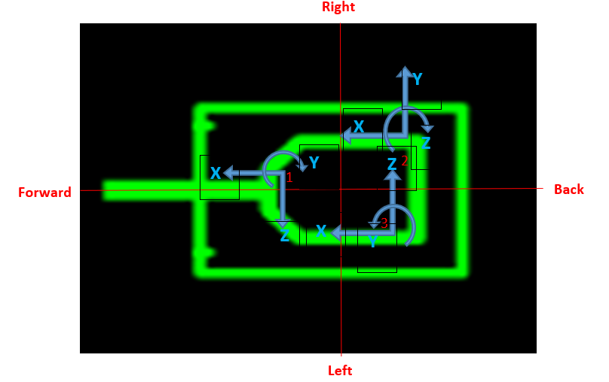
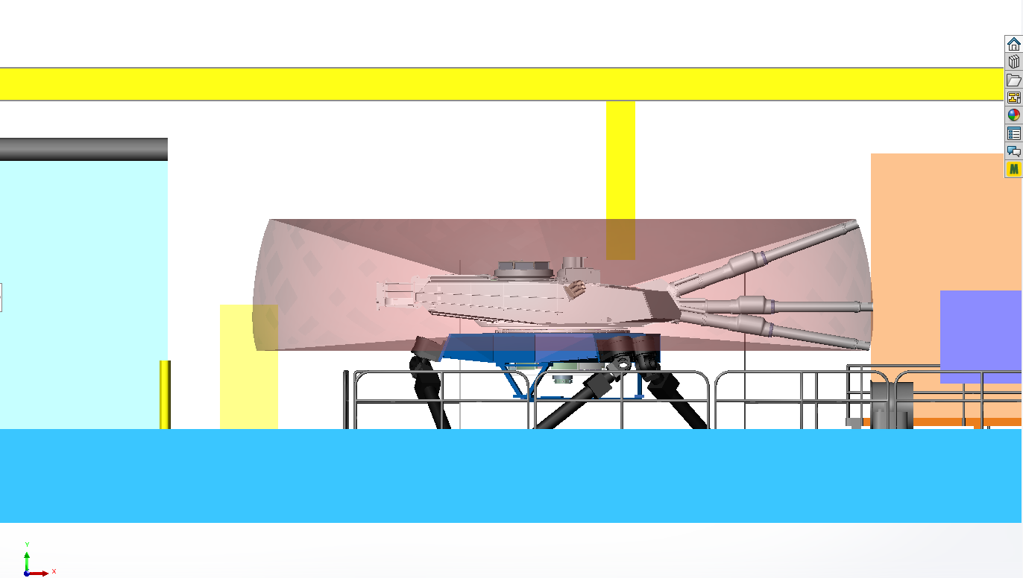
Target File Development
Channel Name | Orientation
Turret Pitch Gyro | +down
Turret Roll Gyro | +right
Hull Yaw Gyro | +cw
Gun Trun Accel (Tri-axial) | X Fwd
 | Y Down
 | Z Left
Cmdr Accel (Tri-axial) | X Fwd
 | Y Right
 | Z Down
Loader Accel (Tri-axial) | X Fwd
 | Y Up
 | Z Right
How do we manipulate the field data?
Scale (units) and orient all the signals for CS/TMBS coordinates
        mils/s→rad/s, Gs →m/s²
        x, y, z (+fwd, +right, +down)/ roll, pitch, yaw (+right, +up, +cw)
Calculate the 3 angular accelerations
        2-sided derivatives of rates
Translate/Average Accel Signals
Trim and fade the data
        1 second, sinusoidal fade in/out
Low-Pass Filter channels at 10Hz
        Lowest DOF bandwidth
X
Y
Z

Slide 12
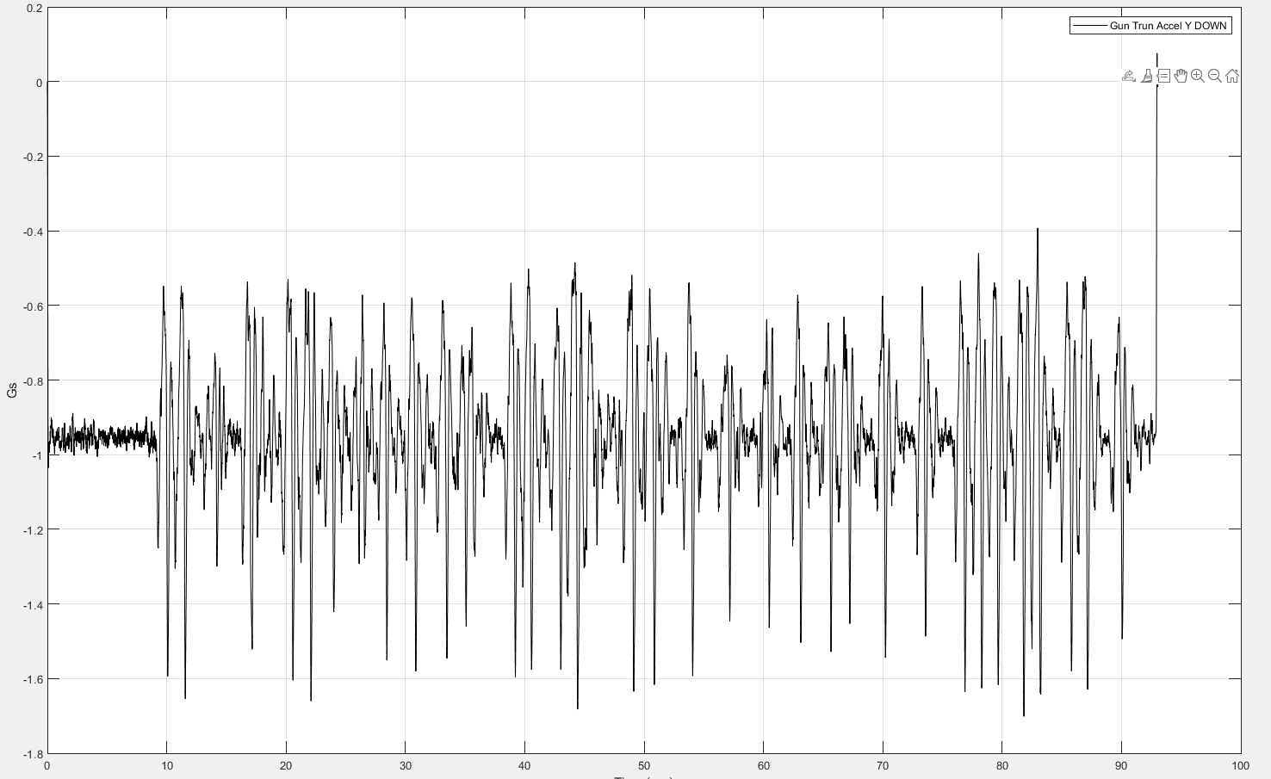
Target Response Accuracy
How well does the drive match the field?
Processed Vertical Accel (+ Down)
m/s²
Gun Trunnion Vertical Accel (+ Down)
Gs

Slide 13
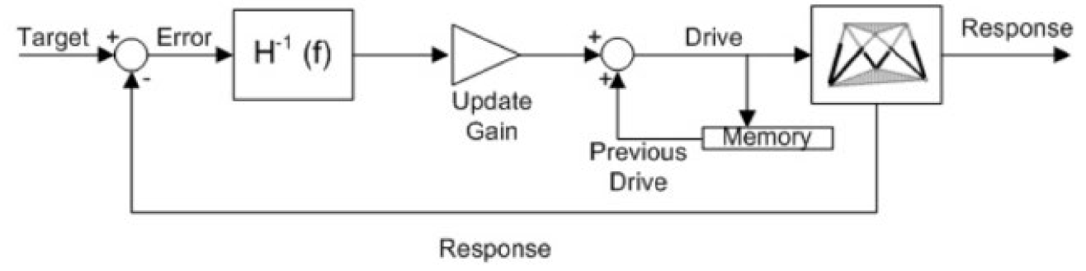
Iterations
Why do we iterate?
Insufficient tuning
Variable payload
Nonlinear considerations
    Mechanical wear
    Oil properties/resonance
    What are iterations?
    Iterative process in which command inputs are incrementally modified to a achieve desired response
    Utilizes formally known methods
    Time Waveform Replication
    Iterative Learning Control

Slide 14
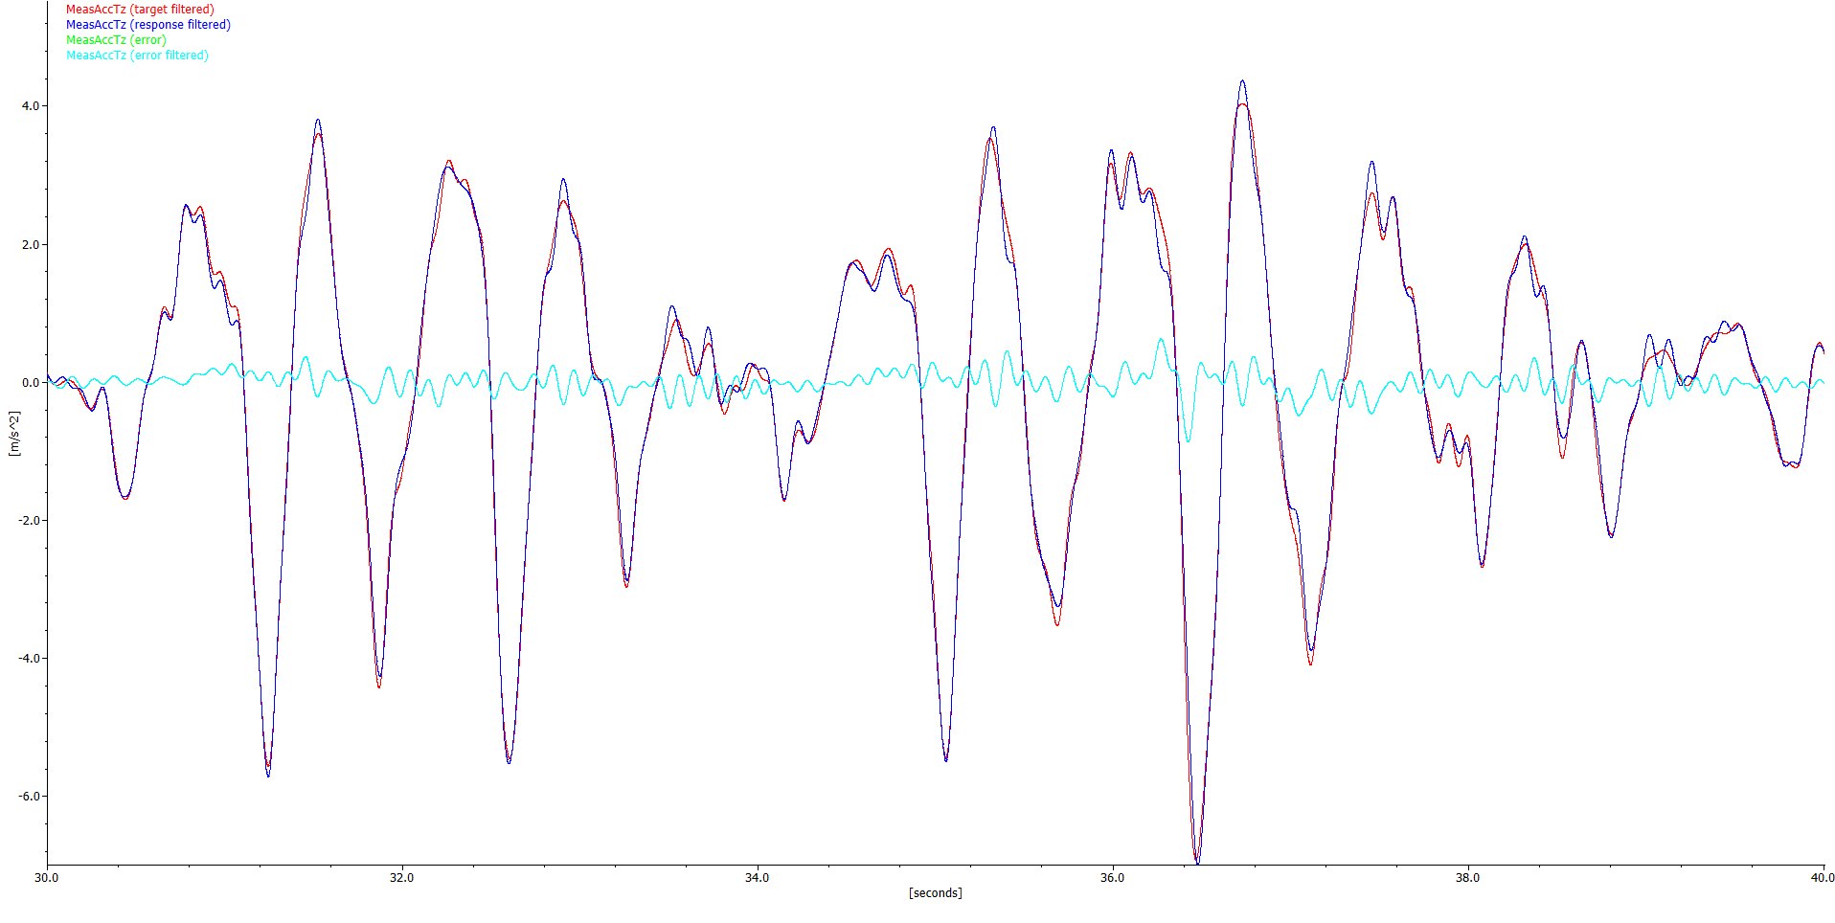
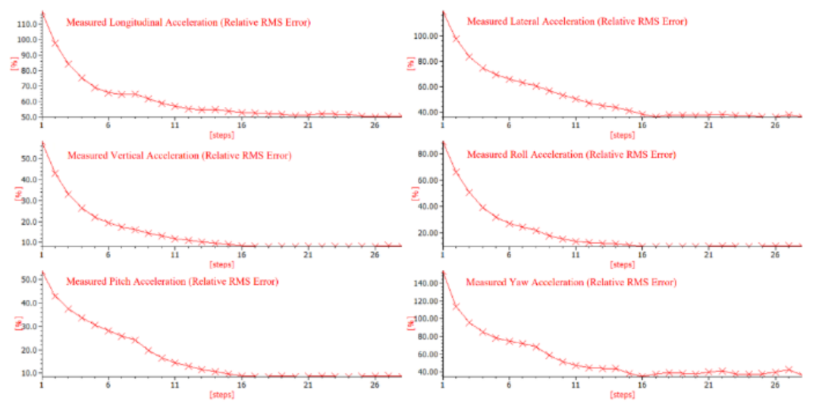
Iterations (continued)
Iteration Prerequisites
Target File (desired response)
System Model
Play multi-spectral white noise in each DoF
Measure simulator response in all 6 DoFs
Calculate 6x6 H(f) matrix
Iteration Process
Error Calculation
Compare target and response to generate an "error signal"
Feed error into the inverse system model
Corrective Signal Generation
Controller utilizes the error signal and inverse model to
calculate a correcting signal (FFT)
Drive File Update
Scale corrective signal and apply it to the previous drive

Slide 15
Accuracy

Slide 16
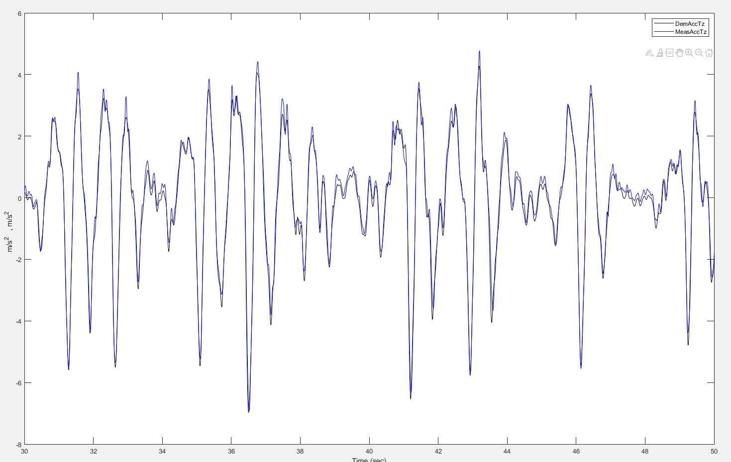
CS/TMBS Accuracy
H-Field @ 11 MPH
(Z acceleration +Down)

Slide 17
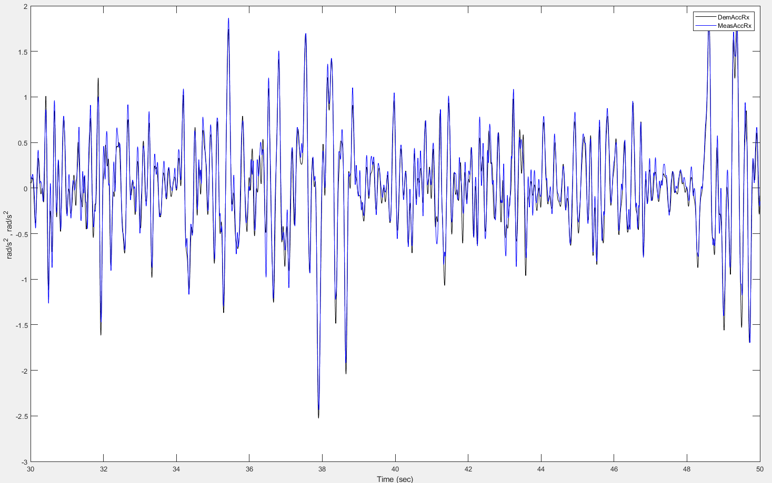
CS/TMBS Accuracy
H-Field @ 11 MPH (Roll acceleration +Right)

Slide 18
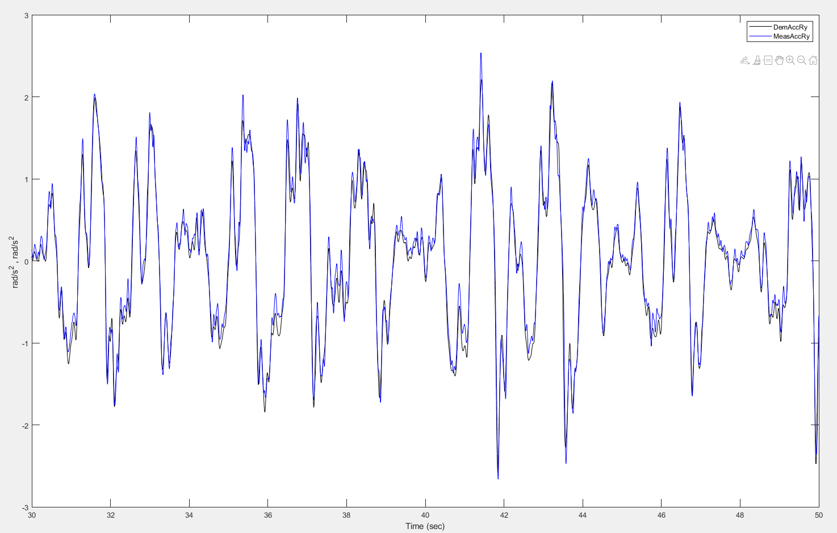
CS/TMBS Accuracy
H-Field @ 11MPH
(Pitch acceleration +UP)

Slide 19
Response vs Target Stats – H-Field @ 11mph
Channel | Unit | Target Min | Response Min | % Error Min | Target Max | Response Max | % Error Max | Target RMS | Response RMS | % Error RMS | Target Range | Response Range | Target Mean | Response Mean | Target StdDev | Response StdDev | Target Variance | Response Variance
MeasAccTx | m/s^2 | -2.718 | -3.203 | 17.828 | 3.575 | 3.714 | 3.889 | 0.838 | 0.922 | 10.047 | 6.293 | 6.916 | 0.000 | 0.000 | 0.838 | 0.922 | 0.702 | 0.850
MeasAccTy | m/s^2 | -2.515 | -2.599 | 3.343 | 2.065 | 2.086 | 1.054 | 0.448 | 0.469 | 4.513 | 4.580 | 4.685 | 0.000 | 0.000 | 0.448 | 0.469 | 0.201 | 0.220
MeasAccTz | m/s^2 | -6.922 | -7.188 | 3.844 | 5.314 | 5.398 | 1.577 | 1.781 | 1.775 | -0.358 | 12.236 | 12.585 | 0.000 | 0.000 | 1.781 | 1.775 | 3.173 | 3.150
MeasAccRx | rad/s^2 | -3.230 | -3.229 | -0.025 | 2.894 | 2.942 | 1.662 | 0.539 | 0.538 | -0.186 | 6.124 | 6.171 | 0.000 | 0.000 | 0.539 | 0.538 | 0.291 | 0.290
MeasAccRy | rad/s^2 | -2.575 | -2.724 | 5.807 | 2.321 | 2.486 | 7.122 | 0.789 | 0.785 | -0.456 | 4.896 | 5.210 | 0.000 | 0.000 | 0.789 | 0.785 | 0.622 | 0.616
MeasAccRz | rad/s^2 | -0.886 | -0.945 | 6.727 | 0.501 | 0.535 | 6.772 | 0.115 | 0.124 | 8.183 | 1.387 | 1.481 | 0.000 | 0.000 | 0.115 | 0.124 | 0.013 | 0.015
Note: Some Drives were played at 85% gain to more closely replicate previous field data to response from turret sensors.

Slide 20
Repeatability

Slide 21
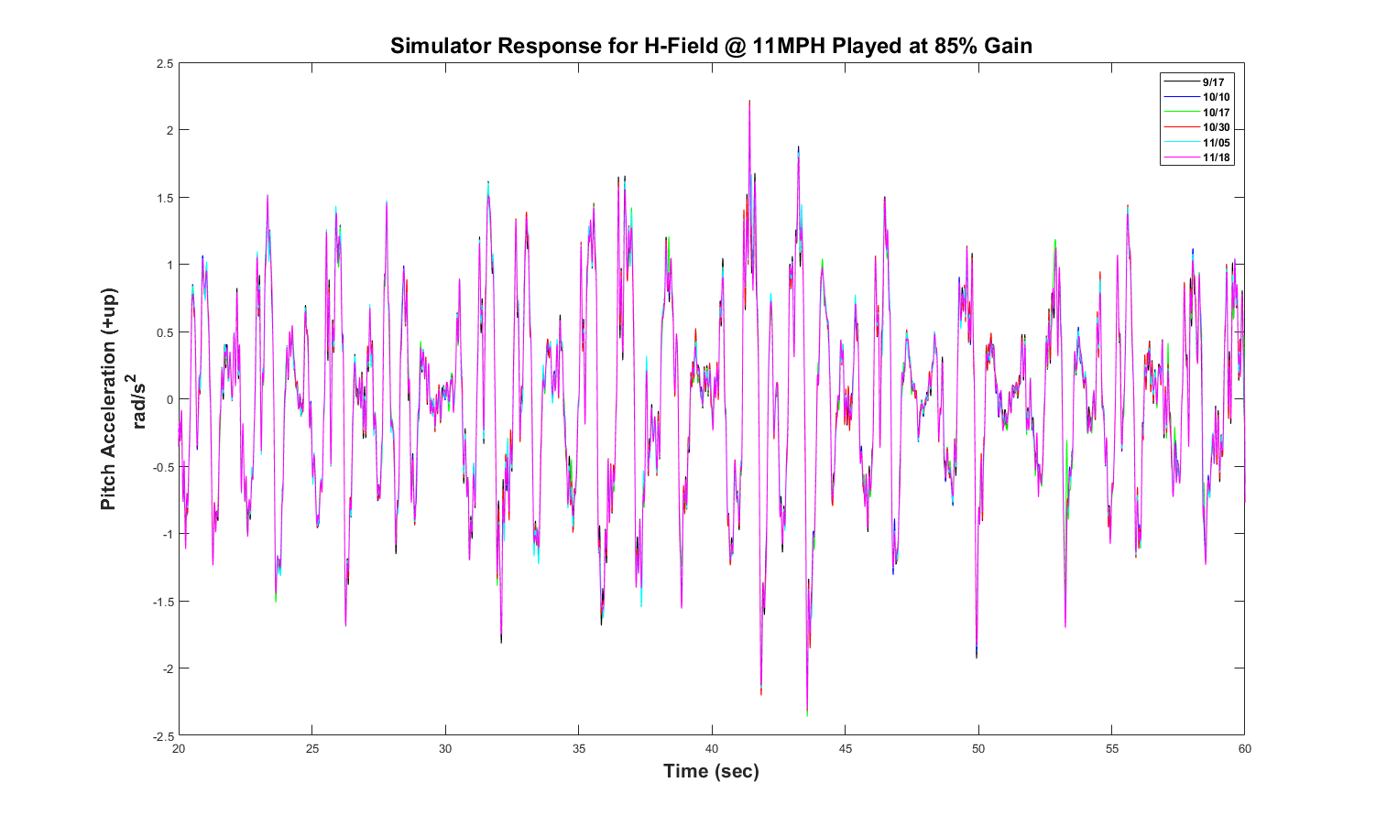
Repeatability
Testing occurred over a two-month period
Platform engineers visually sampled 6/22 runs (same terrain) over that period
Repeatability analysis also looked at all runs across the period.
Axis | Units | Baseline RMS | Ave RMS | Std Dev | Ave Axis RMS Error (%)
X | m/s^2 | 1.3716 | 1.2713 | 0.1015 | 6.90%
Y | m/s^2 | 0.7527 | 0.7710 | 0.0466 | 4.55%
Z | m/s^2 | 1.5779 | 1.5778 | 0.0071 | 0.34%
Roll | rad/s^2 | 0.5397 | 0.5352 | 0.0063 | 2.28%
Pitch | rad/s^2 | 0.7282 | 0.7261 | 0.0023 | 0.35%
Yaw | rad/s^2 | 0.2554 | 0.2391 | 0.0178 | 8.83%
Platform acceleration repeatability statistics across all runs of
H-Field course @ 11MPH played at 85% gain
Axis | Units | Baseline RMS | Ave RMS | Std Dev | Ave Axis RMS Error (%)
Roll | rad/s | 0.0339 | 0.0340 | 0.0002 | 0.54%
Pitch | rad/s | 0.1127 | 0.1132 | 0.0003 | 0.40%
Yaw | rad/s | 0.0129 | 0.0130 | 0.0001 | 0.60%
Roll | NATO mils/s | 34.4813 | 34.5848 | 0.1876 | 0.54%
Pitch | NATO mils/s | 114.8395 | 115.2652 | 0.2900 | 0.40%
Yaw | NATO mils/s | 13.1590 | 13.2248 | 0.0651 | 0.60%
Platform angular velocity repeatability statistics across all runs of
H-Field course @ 11MPH played at 85% gain

Slide 22
Summary
Safety & Payload: Safely operated the platform over design capacity with large payload motion envelope.
Target Development: Field data is carefully scaled, translated, and filtered (10Hz) to build precise target files.
Iterations: Used Moog Replication Software to correct for simulator performance by iteratively applying corrections to previous drive.
High Accuracy: Simulator responses demonstrated high-fidelity correlation and minimal errors against actual field recorded data.
Proven Repeatability: A two-month testing period confirmed stable, consistent responses across all six degrees of freedom.

Slide 23
QUESTIONS?

Slide 24
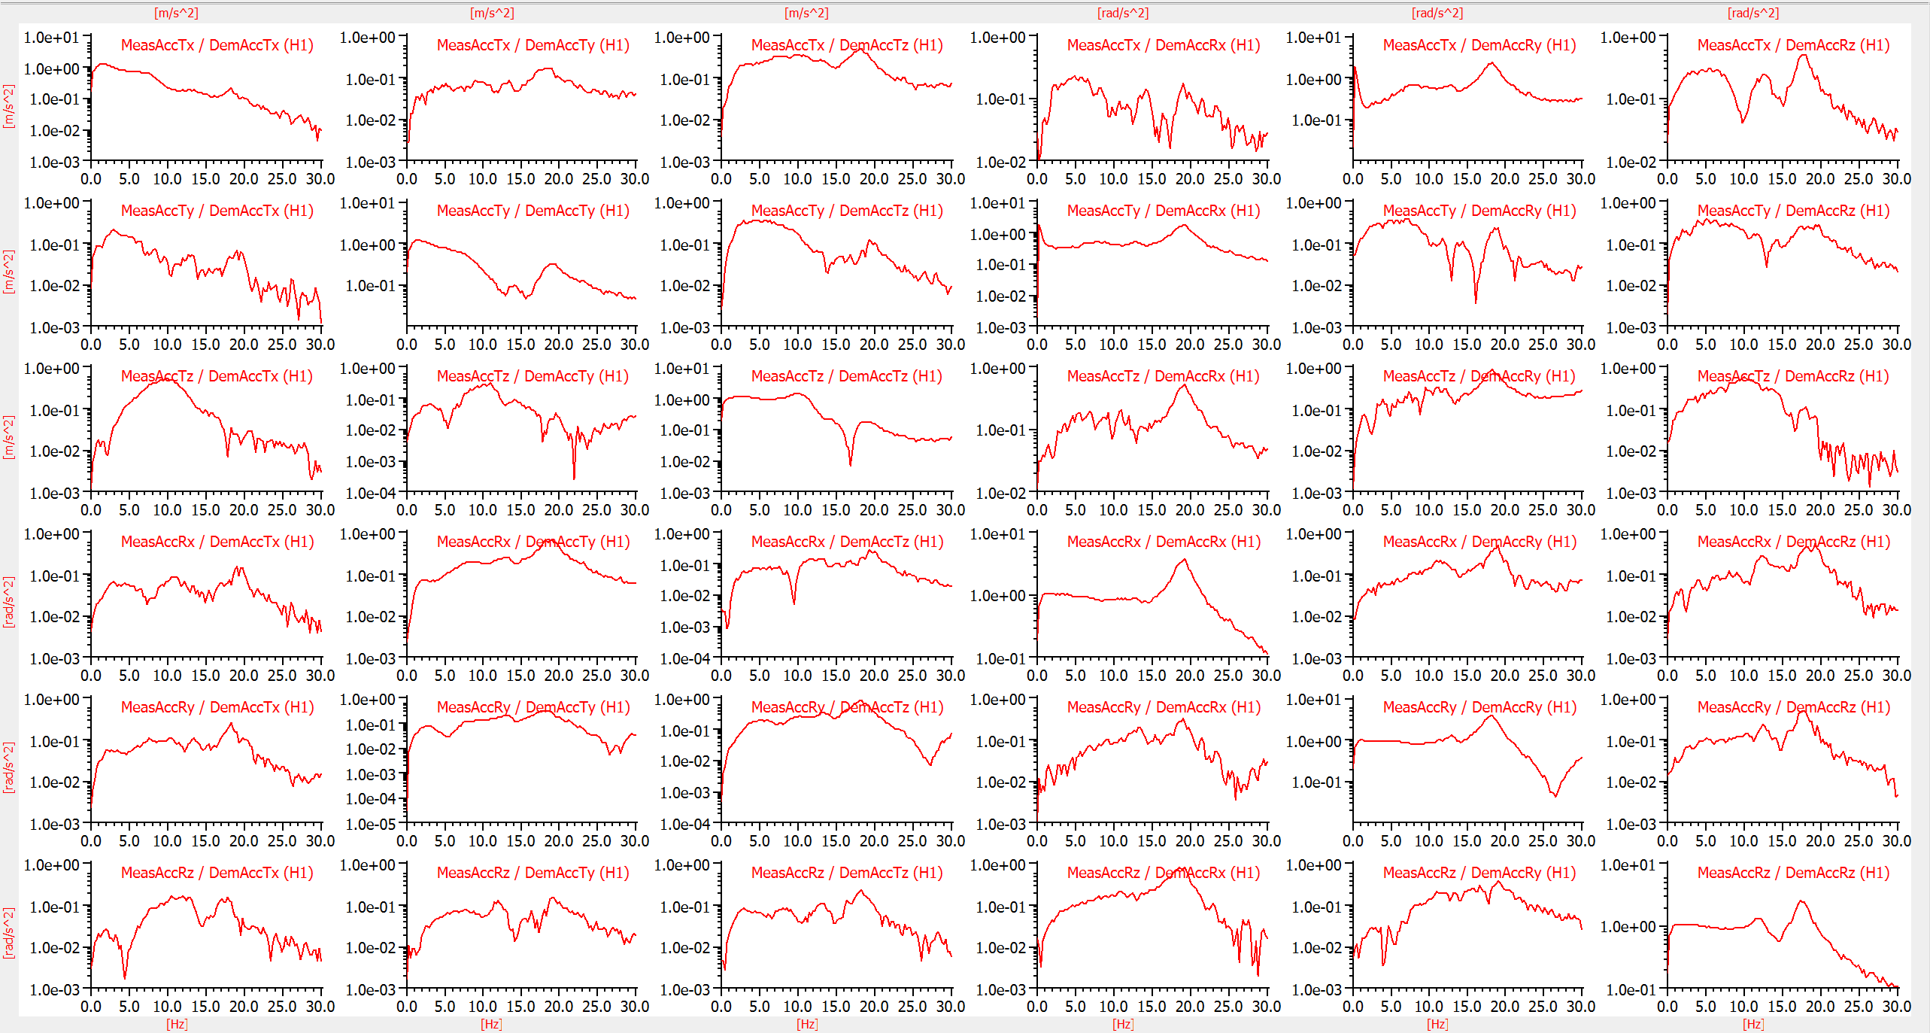
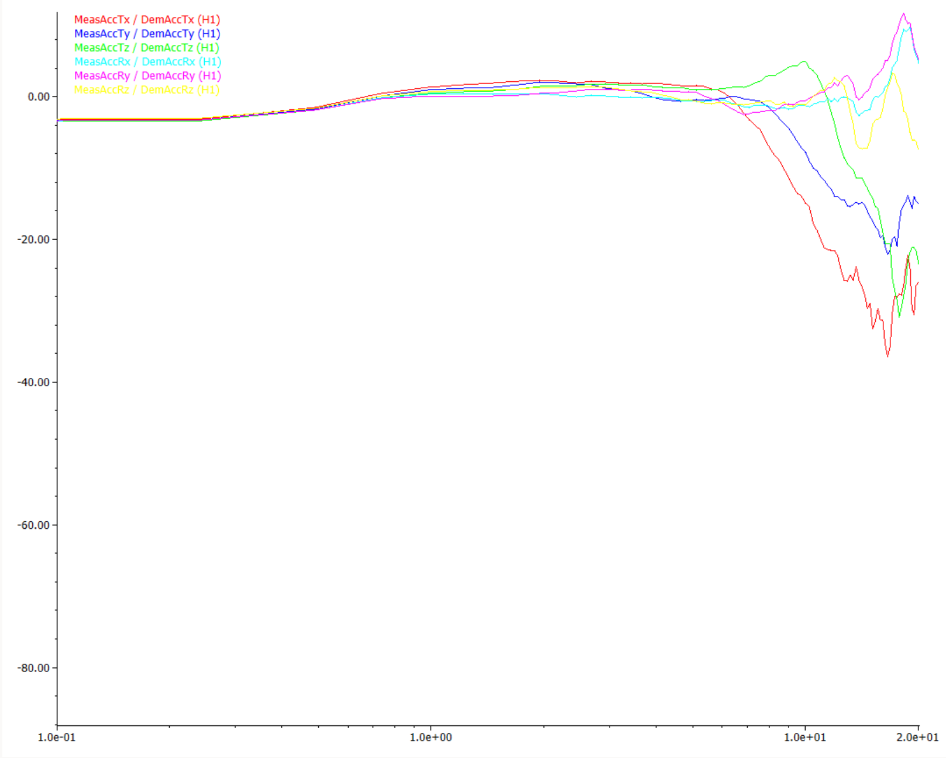

Magnitude (dB)
Frequency (Hz)

Slide 26
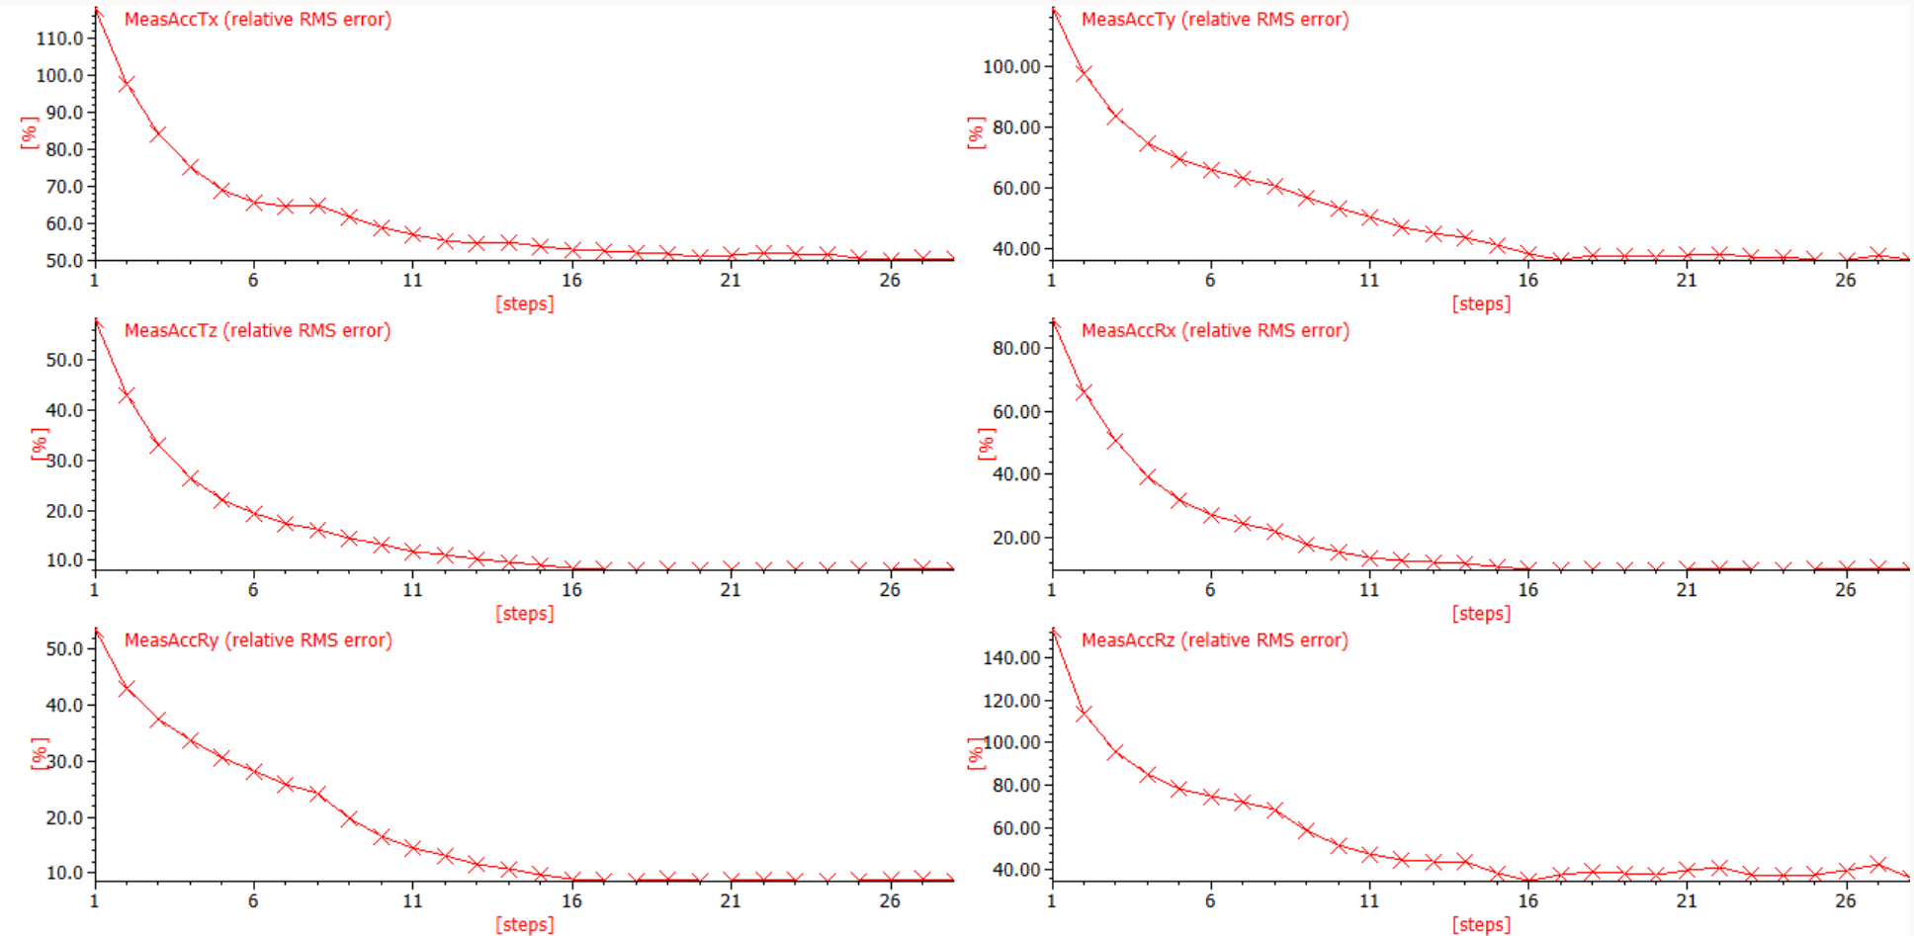

Slide 28
